Slide 1
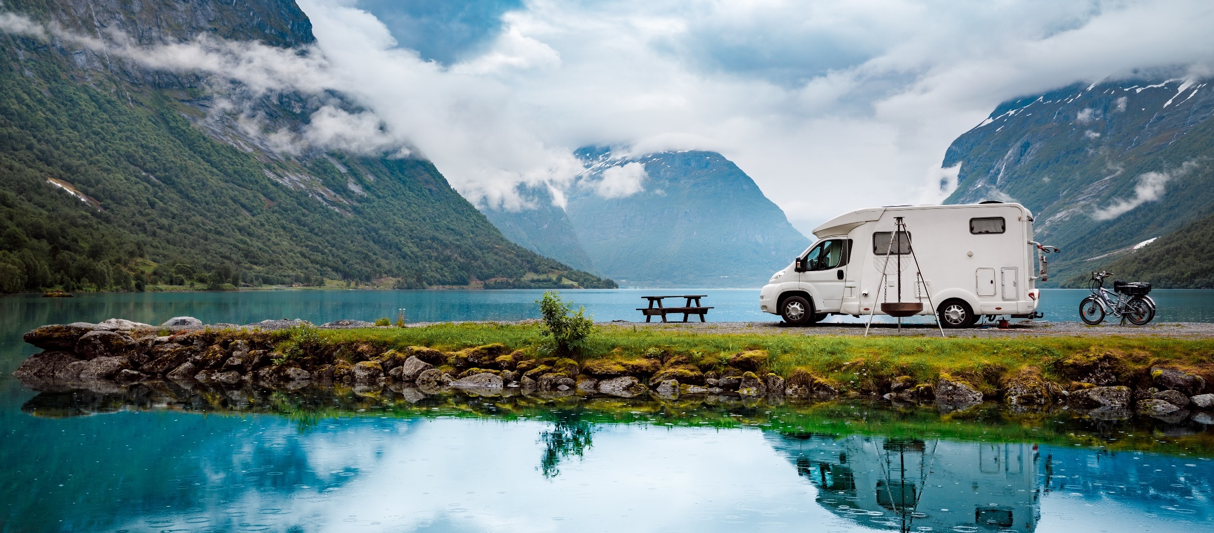


MONITORING SENTIMENT FOR DOMESTIC
AND INTRA-EUROPEAN TRAVEL
WAVE 12 | 06/22

Slide 2
WAVE 12
RESEARCH HIGHLIGHTS
This report monitors sentiment and short-term intentions for domestic and intra-regional travel within Europe and is the 12th wave of market research¹ initiated in September 2020. Responses are collected from Europeans in 10 high-volume source markets.
Travel sentiment remains strong, with 73% of surveyed Europeans planning to travel in the next 6 months, out of which 60% intend to travel more than once.
84% of travellers intend to take a trip during June-September, with peak interest in visiting Mediterranean destinations.
The war in Ukraine did not affect the holiday plans of 44% of Europeans, while it caused 31% to make some changes to their original plans, and 4% cancelled their trip completely.
Over one-third of Europeans state that their travel plans are unaffected by COVID-19 — the largest share since August 2020.
2
¹The data collection and research methodology are detailed in the methodological annex (slide 45)

Slide 3
WAVE 12
RESEARCH HIGHLIGHTS
Sun & Beach (22%), Nature & Outdoors (15%) and City Break (15%) are the most preferred types of leisure trips for Europeans for summer 2022.
Spending time in the great outdoors, seeing scenic European landscapes (19%), immersion in the local lifestyle (16%), and learning more about local gastronomy and delicacies (16%) are travellers’ most coveted experiences for their upcoming summer trip.
39% of Europeans will embark on a family vacation in the next six months, and 37% will travel with their partner.
47% of European travellers will take a plane to their next holiday destination, while 38% will drive.
The 4-6 nights holidays are the most popular (34%), followed by 7-9 nights (27%); 31% of survey respondents plan to invest 500-1,000 euros per person on their upcoming trip.
Over half of European travellers (52%) favour hotel stays, while interest in short-term rentals (15%) increases slightly compared to last summer (13%)
3

Slide 4

WAVE 12
RESEARCH HIGHLIGHTS
Pleasant weather, attractive deals and fewer crowds are the key criteria for the selection of a travel destination.
Europeans’ travel confidence rises, as indicated by the increase in the share of Europeans who have fully booked their upcoming trip (+6%) and the decrease in the level of uncertainty regarding the destination of their next trip (-4%).
Economic concerns regarding price inflation and personal finances are travellers’ key source of distress (31%), while the war in Ukraine (14%) emerges as an additional concern.
Although sentiment towards strict health & safety protocols drops (-12%) to its lowest point, the protocols remain essential for the comfort of 55% of European travellers
4

Slide 5

WAVE 12
RECOMMENDATIONS FOR DESTINATIONS
The expected travel peak from June to September, together with travellers’ preference for less crowded destinations, is an opportunity to promote lesser-known sites and attractions with better value for money deals.
Considering the popularity of nature and outdoors trips, destinations could target, both domestic visitors and travellers from neighbouring countries: 35-54-year-old travellers on family trips and couples aged 54+ who want to enjoy nature and the landscape.
Ιn response to the high intentions to travel more than once in the warmer months, destinations are advised to plan campaigns aimed at attracting the first and subsequent waves of summer trips, with special offerings for return visits.
‘Localhood’ is of prime interest to Europeans; destinations are urged to promote local experiences that enable visitors’ immersion in the local culture and foster a positive interaction between local communities and visitors.
5

Slide 6

WAVE 12
RECOMMENDATIONS FOR BUSINESSES
Coastal hotels/resorts targeting families may consider promoting packages of 4-9 nights complemented by travel experiences revolving around nature and the local cuisine, based on this segment’s high level of interest in such activities.
Bargains and attractive deals are now the second-most important criteria for Europeans when choosing a holiday destination. Businesses are encouraged to bundle tour packages at a reduced price or enhance their value with added experiences at no extra cost.
As Europeans’ travel confidence grows and the booking window elongates, businesses can already launch campaigns for the shoulder months since 75% of trips planned for the next 3-4 months are not yet fully booked.
Tourism businesses should maintain strict health & safety protocols, which remain highly important for over half of Europeans, even though travel concerns, specifically related to COVID-19, drop.
6

Slide 7
CONTENTS
01. | 02. | 03. | 04.
TRAVEL | TRIP | TRAVEL | METHODOLOGICAL
INTENTIONS | PLANNING | CONCERNS | ANNEX
P. 9 | P. 28 | P. 39 | P. 44

Slide 8
How to read
Wave 12
Dates on the graphs refer to the following data collection periods for each research wave:
To present Wave 12 ‘timings in which respondents are most likely to take their next trip’, the following time periods should be used as a reference:
  In 1-2 months; June-July 2022
  In 3-4 months; August-September 2022
  In 5-6 months; October-November 2022
To present data and insights, the following distinct groups have been analysed:
  Total respondents; 6,005
  Respondents with short-term travel plans/most likely to travel in the next 6 months
  (‘early-bird’ travellers/ ’travel-ready’ Europeans); 4,391
  Respondents selecting outbound European destinations; 4,463
Significant changes between current and previous waves are calculated on a 2.5% significance level.
Statistically significant differences are marked using the following symbols:
  Increasing , decreasing
  Numbers next to the arrows reflect the actual change in the share of respondents selecting a specific response between current and previous waves
All data and insights refer to domestic and intra-European travel, unless otherwise stated.
 | Wave 9 | Wave 10 | Wave 11 | Wave 12
Survey dates | 10-18 Sep ‘21 | 23-31 Dec ‘21 | 1-9 March ‘22 | 9-12 May 2022
8

Slide 9
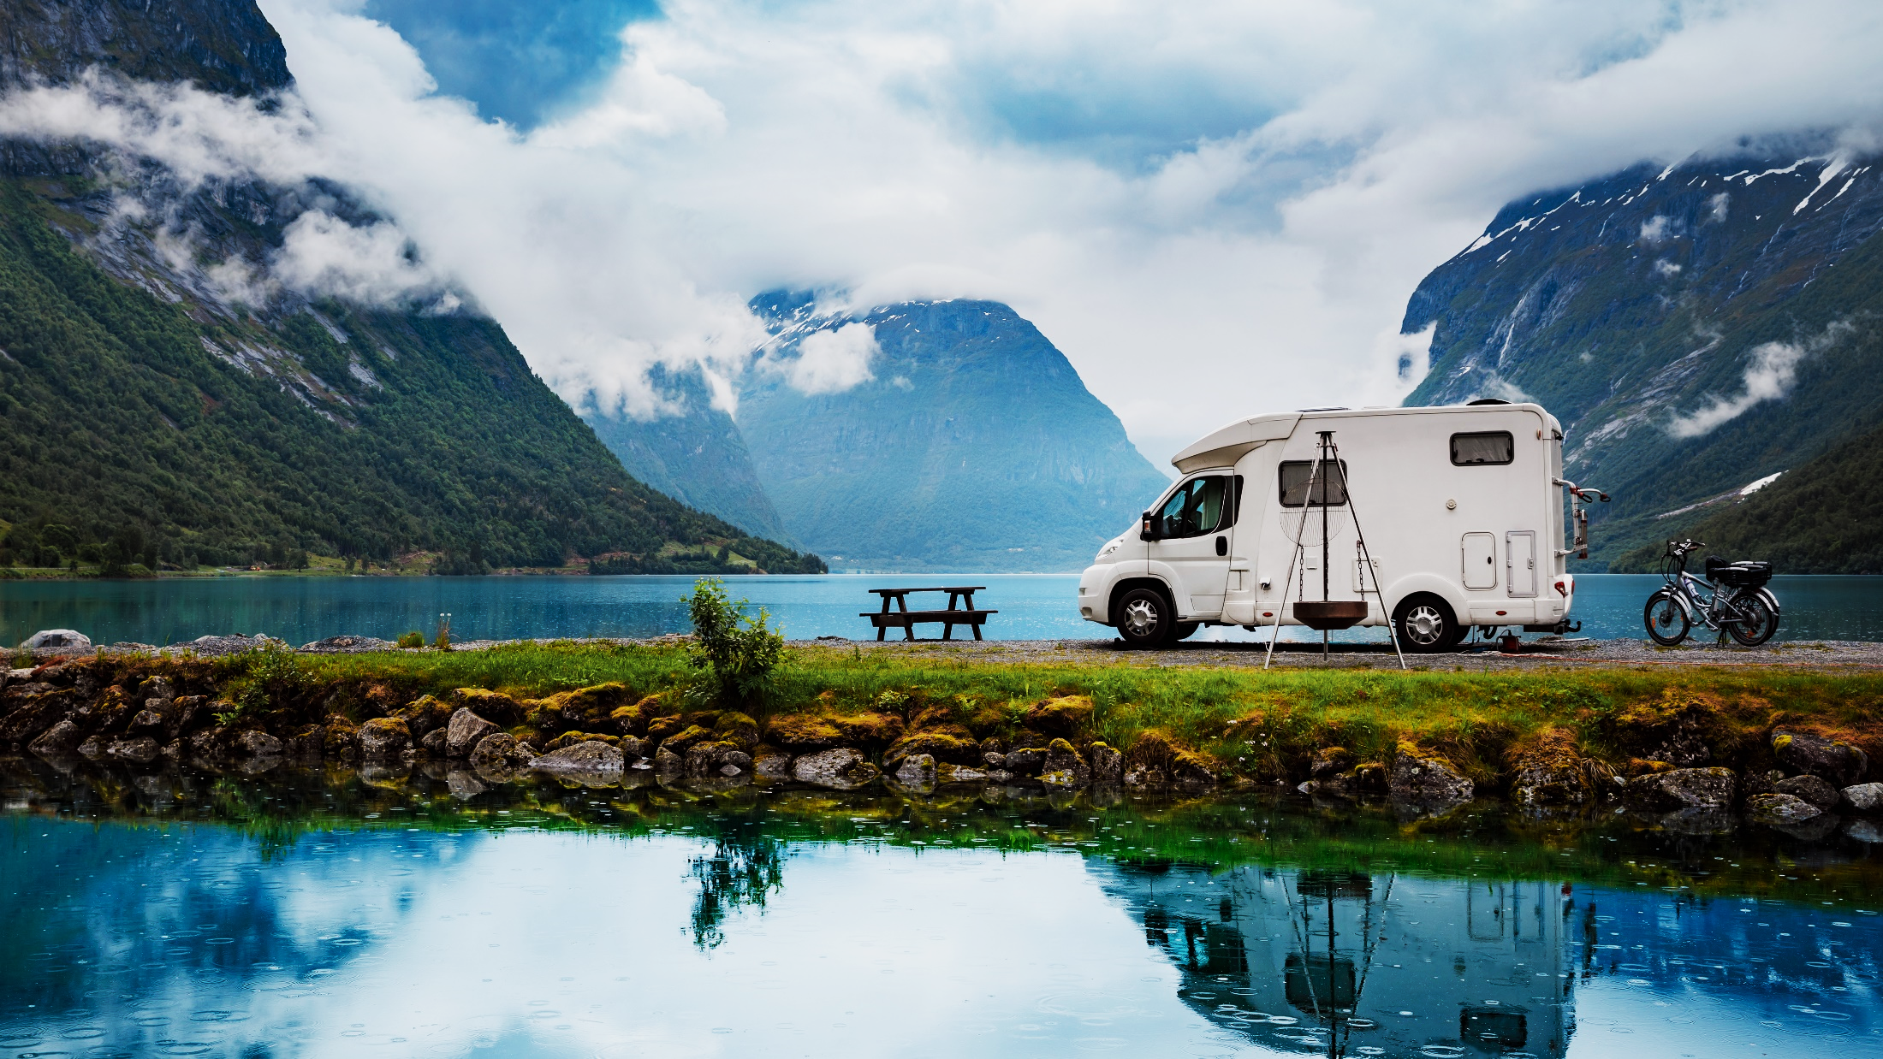
TRAVEL
INTENTIONS
01

Slide 10





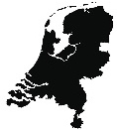
With summer coming, Europeans’ travel sentiment remains strong despite a minor drop (-4%)
Top 5 markets that are most likely
to travel in the next 6 months
Intention to travel in the next 6 months
Poland
86.9%
Germany
Spain
77.2%
3.7%*
78.8%
Italy
7.5%*
Netherlands
77.1%
7%*
77.8%
10
Q9. Do you plan to take an overnight trip domestically or within Europe in the next 6 months, either for personal or professional purposes?
* Statistically significant difference vs previous survey period
No. of respondents: 6,005

Slide 11





Europeans aged 45+ remain the most eager to travel (78%), while sentiment among the youngest travellers (18–24 years old) is slightly weaker (62%)
18-24
Intention to travel in the next 6 months by age group
Concerns regarding the economic situation, COVID-19 and the war in Ukraine are similar among all age groups, regardless of their travel sentiment
25-34
35-44
45-54
≥55
May ‘22 survey
11
Q9. Do you plan to take an overnight trip domestically or within Europe in the next 6 months, either for personal or professional purposes?
No. of respondents: 6,005

Slide 12
Desire to travel is equally distributed between June-July (41%) and August-September (42%),
with strong interest in intra-European travel
When will Europeans travel next?
Where will Europeans travel within the next 6 months?
69.7%
June-September
55.3%
within Europe
50.3%
within Europe
55.8%
within Europe
57.5%
within Europe
83.7%
June-September
Q12. When are you most likely to go on your next trip either in your country or within Europe?
Q13. Where do you plan to travel in the next 6 months?
12
* NOTE: ‘This month’ is excluded from answering options from Wave 10 onwards
** No statistically significant differences between waves were recorded
No. of respondents: 4,391

Slide 13
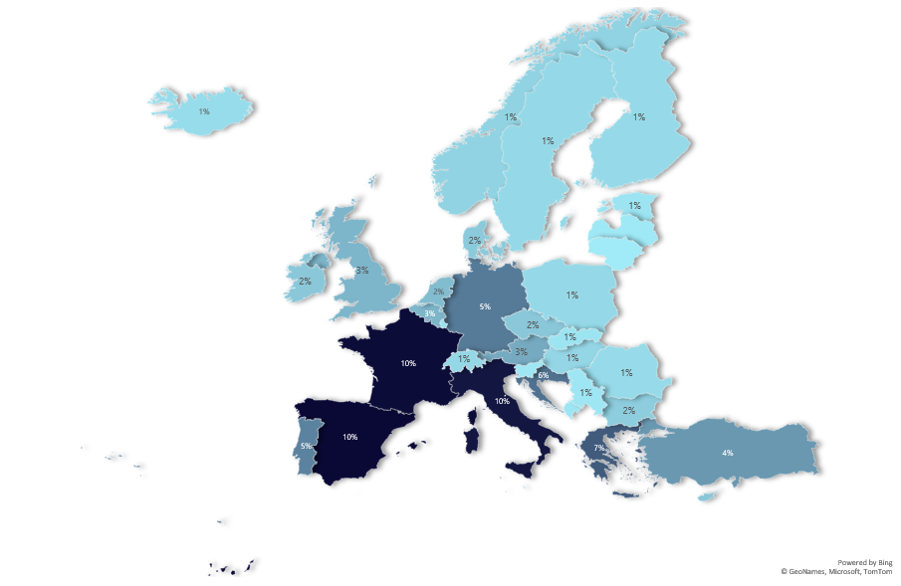
May ‘22 survey
PREFERRED COUNTRIES
FOR EUROPEANS’ NEXT
INTERNATIONAL TRIP
Croatia reaches the top 5 list, while Belgium enters the
top 10 for the first time
TOP 10 COUNTRIES
<1%
<1%
Spain | 10.2%
France | 10.1%
Italy | 9.6%
Greece | 6.6%
Croatia | 5.6%
Germany | 5.2%
Portugal | 4.9%
Turkey | 4.0%
Austria | 3.2%
Belgium | 2.7%
1%
*Please use this map as a reference only
No. of respondents: 4,463
13
Q14. To which country(ies) do you plan to travel next?
* No statistically significant differences between waves were recorded

Slide 14




Despite a minor decline, the vast majority of Europeans (73%) will still travel for leisure purposes in the following months
Purpose of travel for respondents
most likely to travel in the next 6 months
Top 3 markets to take a leisure trip
Top 3 markets to take a business trip
Italy
Switzerland
80,3%
12,6%
2.7%*
Netherlands
10.5%*
Austria
80,0%
6,7%
Spain
Poland
77,7%
4,6%
* Statistically significant change vs previous survey period
**In May ‘22, ‘For an event for personal reasons’ replaced ‘For a conference or event’
14
Q11. For what reason are you most likely to travel within Europe next?
Results for business trip per country are indicative due to small sample bases
No. of respondents: 4,391

Slide 15

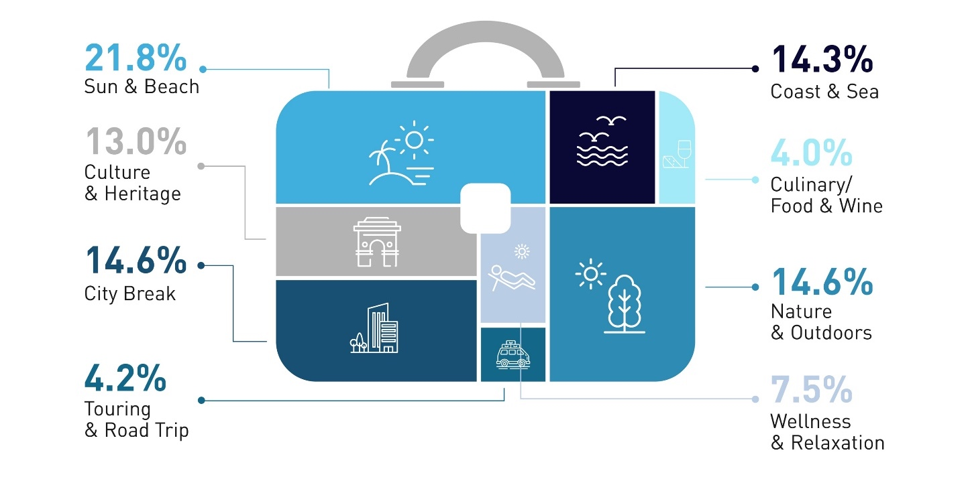
Sun & Beach holidays are the most popular type of holidays; Nature & Outdoors and City Breaks climb to second place for the next 6 months
Preferred type of leisure trip for respondents most likely to travel in the next 6 months
Compared to Sun & Beach holidaymakers, Nature & Outdoors travellers are more likely to travel domestically (48% vs. 35%) or to a neighbouring country (41% vs. 35%)
May ‘22 survey
“Coast & Sea” and “Sun & Beach“ holidays are separated in this survey because some destinations like the Netherlands, Denmark, the Baltic countries, etc., offer coast & sea experiences and sports (e.g. sailing) but they are not necessarily associated with sun & beach vacations and experiences like Spain, Italy, Greece, etc.
15
* Statistically significant difference vs previous survey period
Q18. What type of leisure trip within Europe are you most likely to undertake next?
No. of respondents: 4,391

Slide 16
Sun and Beach holidays are more alluring to younger and middle-aged travellers (18-44 years old),
while those 55+ demonstrate a stronger preference for Culture and Heritage trips
Top 5 types of trip by age group
prefe
18-24
25-34
35-44
45-54
≥55
16
Q18. What type of leisure trip within Europe are you most likely to undertake next?
No. of respondents: 6,005

Slide 17








WHAT ARE THE TRAVEL STYLES OF EUROPEANS
MOST WILLING TO TRAVEL IN THE NEXT MONTHS?
1 in 3 Europeans who intend to travel in the next 6 months describe themselves as City Life Enthusiasts who love visiting metropolitan areas and enjoying the variety of experiences they offer.
The Sun & Beach Lovers and the Immersive Explorers are the other two big travel segments among Europeans planning to travel in the coming months.
The travel style reveals the true interest of travellers, regardless of the season or destination.
It should be considered by destinations and tourism products and service developers as it can help optimise the travel experience.
17
Q1. Which of the following statements best describes your travel preferences?
No. of respondents: 4,391

Slide 18
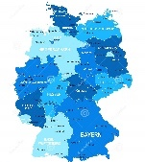









A SNAPSHOT OF GERMAN TRAVEL PLANS
Travel horizon: June-November 2022
TRAVEL SENTIMENT | TRAVEL PLANNING |  | PREFERRED TYPES OF TRIPS & DESTINATIONS
INTENTION TO TRAVEL
WHERE TO?
AND WITH WHOM?
TOP 3 TYPES OF TRIPS
NEIGHBOURING COUNTRY
31%
Sun & Beach
6%*
31%
NON-NEIGHBOURING COUNTRY
26%
32%
WITHIN MY COUNTRY
5%*
Nature & Outdoors
45%
with family
33%
with partner
10%
solo
TRAVEL READINESS
19%
7%*
9%
OUTSIDE
EUROPE
Destination not chosen
Trip fully booked
Coast & Sea
Destination chosen but trip not booked yet
INTENDED LENGTH OF STAY AND BUDGET
18%
Trip partially booked
POPULAR TRAVEL PERIODS
TOP 5 EUROPEAN DESTINATIONS**
Italy | 11%
Spain | 10%
Austria | 9%
Greece | 8%
Turkey | 8%
48%
35%
11%
June-
July ‘22
August-September‘22
October- November ‘22
The intended budget is per person, including accommodation, transportation and travel activities
* Significant increase or decrease vs previous survey period
** Based on total sample, without reference to domestic trips
No. of respondents: 751 (total sample of respondents per country)

Slide 19
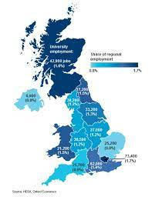

A SNAPSHOT OF BRITISH TRAVEL PLANS
Travel horizon: June-November 2022
TRAVEL SENTIMENT | TRAVEL PLANNING |  | PREFERRED TYPES OF TRIPS & DESTINATIONS
INTENTION TO TRAVEL
WHERE TO?
AND WITH WHOM?
TOP 3 TYPES OF TRIPS
14%*
Sun & Beach
ANOTHER EUROPEAN COUNTRY
51%
30%
33%
WITHIN MY COUNTRY
43%
with family
35%
with partner
9%
solo
City Break
TRAVEL READINESS
OUTSIDE
EUROPE
20%
11%
Destination not chosen
Trip fully booked
INTENDED LENGTH OF STAY AND BUDGET
Coast & Sea
Destination chosen but trip not booked yet
Trip partially booked
13%
5%*
POPULAR TRAVEL PERIODS
TOP 5 EUROPEAN DESTINATIONS**
Spain | 17%
Italy | 9%
France | 8%
Greece | 7%
Portugal | 5%
31%
33%
16%
June-
July ‘22
August-September‘22
October- November ‘22
The intended budget is per person, including accommodation, transportation and travel activities
* Significant increase or decrease vs previous survey period
** Based on total sample, without reference to domestic trips
No. of respondents: 751 (total sample of respondents per country)

Slide 20
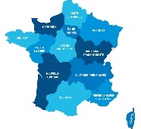

A SNAPSHOT OF FRENCH TRAVEL PLANS
Travel horizon: June-November 2022
TRAVEL SENTIMENT | TRAVEL PLANNING |  | PREFERRED TYPES OF TRIPS & DESTINATIONS
INTENTION TO TRAVEL
WHERE TO?
AND WITH WHOM?
TOP 3 TYPES OF TRIPS
NEIGHBOURING COUNTRY
34%
Culture & Heritage
NON-NEIGHBOURING COUNTRY
14%
19%
37%
WITHIN MY COUNTRY
37%
with family
36%
with partner
11%
solo
TRAVEL READINESS
8%*
Sun & Beach
18%
5%*
Destination not chosen
Trip fully booked
11%
OUTSIDE
EUROPE
9%*
INTENDED LENGTH OF STAY AND BUDGET
Coast & Sea
Destination chosen but trip not booked yet
Trip partially booked
17%
5%*
POPULAR TRAVEL PERIODS
TOP 5 EUROPEAN DESTINATIONS**
Italy | 12%
Spain | 11%
Greece | 9%
Portugal | 8%
Croatia | 6%
33%
42%
13%
June-
July ‘22
August-September‘22
October- November ‘22
The intended budget is per person, including accommodation, transportation and travel activities
* Significant increase or decrease vs previous survey period
** Based on total sample, without reference to domestic trips
No. of respondents: 750 (total sample of respondents per country)

Slide 21
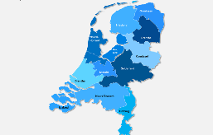
A SNAPSHOT OF DUTCH TRAVEL PLANS
Travel horizon: June-November 2022
TRAVEL SENTIMENT | TRAVEL PLANNING |  | PREFERRED TYPES OF TRIPS & DESTINATIONS
INTENTION TO TRAVEL
WHERE TO?
AND WITH WHOM?
TOP 3 TYPES OF TRIPS
7%*
19%
Sun & Beach
NEIGHBOURING COUNTRY
27%
NON-NEIGHBOURING COUNTRY
44%
18%
WITHIN MY COUNTRY
40%
with family
36%
with partner
11%
solo
Nature & Outdoors
TRAVEL READINESS
19%
Destination not chosen
9%*
Trip fully booked
14%
OUTSIDE
EUROPE
INTENDED LENGTH OF STAY AND BUDGET
City Break
Destination chosen but trip not booked yet
Trip partially booked
17%
8%*
POPULAR TRAVEL PERIODS
TOP 5 EUROPEAN DESTINATIONS**
Spain | 13%
France | 12%
Germany | 8%
Italy | 8%
Belgium | 8%
35%
43%
12%
June-
July ‘22
August-September‘22
October- November ‘22
The intended budget is per person, including accommodation, transportation and travel activities
* Significant increase or decrease vs previous survey period
** Based on total sample, without reference to domestic trips
No. of respondents: 501 (total sample of respondents per country)

Slide 22
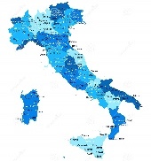

A SNAPSHOT OF ITALIAN TRAVEL PLANS
Travel horizon: June-November 2022
TRAVEL SENTIMENT | TRAVEL PLANNING |  | PREFERRED TYPES OF TRIPS & DESTINATIONS
INTENTION TO TRAVEL
WHERE TO?
AND WITH WHOM?
TOP 3 TYPES OF TRIPS
8%*
Culture & Heritage
NEIGHBOURING COUNTRY
24%
28%
NON-NEIGHBOURING COUNTRY
23%
45%
WITHIN MY COUNTRY
38%
with family
38%
with partner
13%
solo
Sun & Beach
TRAVEL READINESS
18%
Destination not chosen
Trip fully booked
6%
OUTSIDE
EUROPE
Coast & Sea
Destination chosen but trip not booked yet
9%*
INTENDED LENGTH OF STAY AND BUDGET
13%
Trip partially booked
5%*
POPULAR TRAVEL PERIODS
TOP 5 EUROPEAN DESTINATIONS**
France | 16%
Spain | 15%
Greece | 9%
Germany | 7%
Croatia | 5%
35%
44%
11%
June-
July ‘22
August-September‘22
October- November ‘22
The intended budget is per person, including accommodation, transportation and travel activities
* Significant increase or decrease vs previous survey period
** Based on total sample, without reference to domestic trips
No. of respondents: 750 (total sample of respondents per country)

Slide 23
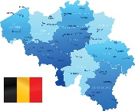
A SNAPSHOT OF BELGIAN TRAVEL PLANS
Travel horizon: June-November 2022
TRAVEL SENTIMENT | TRAVEL PLANNING |  | PREFERRED TYPES OF TRIPS & DESTINATIONS
INTENTION TO TRAVEL
WHERE TO?
AND WITH WHOM?
TOP 3 TYPES OF TRIPS
NEIGHBOURING COUNTRY
37%
Sun & Beach
22%
NON-NEIGHBOURING COUNTRY
30%
16%
WITHIN MY COUNTRY
43%
with family
Nature & Outdoors
TRAVEL READINESS
32%
with partner
13%
solo
18%
Destination not chosen
10%*
Trip fully booked
12%
OUTSIDE
EUROPE
Coast & Sea
Destination chosen but trip not booked yet
INTENDED LENGTH OF STAY AND BUDGET
16%
Trip partially booked
6%*
POPULAR TRAVEL PERIODS
TOP 5 EUROPEAN DESTINATIONS**
France | 24%
Spain | 13%
Italy | 11%
Portugal | 5%
Turkey | 5%
42%
40%
9%
June-
July ‘22
August-September‘22
October- November ‘22
The intended budget is per person, including accommodation, transportation and travel activities
* Significant increase or decrease vs previous survey period
** Based on total sample, without reference to domestic trips
No. of respondents: 500 (total sample of respondents per country)

Slide 24
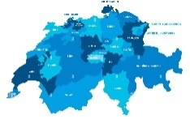
A SNAPSHOT OF SWISS TRAVEL PLANS
Travel horizon: June-November 2022
TRAVEL SENTIMENT | TRAVEL PLANNING |  | PREFERRED TYPES OF TRIPS & DESTINATIONS
INTENTION TO TRAVEL
WHERE TO?
AND WITH WHOM?
TOP 3 TYPES OF TRIPS
NEIGHBOURING COUNTRY
29%
Sun & Beach
23%
17%
NON-NEIGHBOURING COUNTRY
23%
WITHIN MY COUNTRY
26%
with family
22%
with partner
17%
solo
Coast & Sea
TRAVEL READINESS
12%
Destination not chosen
Trip fully booked
16%
OUTSIDE
EUROPE
INTENDED LENGTH OF STAY AND BUDGET
Nature & Outdoors
Destination chosen but trip not booked yet
Trip partially booked
11%
POPULAR TRAVEL PERIODS
TOP 5 EUROPEAN DESTINATIONS**
Italy | 10%
France | 7%
Germany | 7%
Spain | 6%
Portugal | 6%
30%
33%
17%
June-
July ‘22
August-September‘22
October- November ‘22
The intended budget is per person, including accommodation, transportation and travel activities
* Significant increase or decrease vs previous survey period
** Based on total sample, without reference to domestic trips
No. of respondents: 500 (total sample of respondents per country)

Slide 25
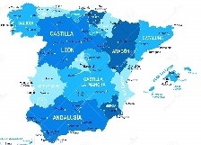
A SNAPSHOT OF SPANISH TRAVEL PLANS
Travel horizon: June-November 2022
TRAVEL SENTIMENT | TRAVEL PLANNING |  | PREFERRED TYPES OF TRIPS & DESTINATIONS
INTENTION TO TRAVEL
WHERE TO?
AND WITH WHOM?
TOP 3 TYPES OF TRIPS
NEIGHBOURING COUNTRY
35%
City Break
33%
NON-NEIGHBOURING COUNTRY
17%
41%
WITHIN MY COUNTRY
37%
with family
43%
with partner
11%
solo
Sun & Beach
TRAVEL READINESS
15%
Destination not chosen
Trip fully booked
4%
OUTSIDE
EUROPE
Culture & Heritage
Destination chosen but trip not booked yet
Trip partially booked
INTENDED LENGTH OF STAY AND BUDGET
15%
7%*
POPULAR TRAVEL PERIODS
TOP 5 EUROPEAN DESTINATIONS**
France | 20%
Italy | 13%
Portugal | 10%
Germany | 7%
UK | 4%
25%
51%
13%
June-
July ‘22
August-September‘22
October- November ‘22
The intended budget is per person, including accommodation, transportation and travel activities
* Significant increase or decrease vs previous survey period
** Based on total sample, without reference to domestic trips
No. of respondents: 500 (total sample of respondents per country)

Slide 26
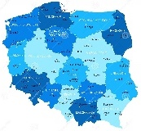
A SNAPSHOT OF POLISH TRAVEL PLANS
Travel horizon: June-November 2022
TRAVEL SENTIMENT | TRAVEL PLANNING |  | PREFERRED TYPES OF TRIPS & DESTINATIONS
INTENTION TO TRAVEL
WHERE TO?
AND WITH WHOM?
TOP 3 TYPES OF TRIPS
NEIGHBOURING COUNTRY
24%
City Break
31%
19%
NON-NEIGHBOURING COUNTRY
34%
WITHIN MY COUNTRY
46%
with family
34%
with partner
9%
solo
Coast & Sea
TRAVEL READINESS
17%
Destination not chosen
6%*
Trip fully booked
6%
OUTSIDE
EUROPE
INTENDED LENGTH OF STAY AND BUDGET
Culture & Heritage
Destination chosen but trip not booked yet
Trip partially booked
14%
POPULAR TRAVEL PERIODS
TOP 5 EUROPEAN DESTINATIONS**
Croatia | 12%
Italy | 10%
Greece | 8%
Germany | 7%
Czech Republic | 7%
40%
43%
6%
June-
July ‘22
August-September‘22
October- November ‘22
The intended budget is per person, including accommodation, transportation and travel activities
* Significant increase or decrease vs previous survey period
** Based on total sample, without reference to domestic trips
No. of respondents: 502 (total sample of respondents per country)

Slide 27
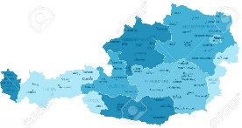
A SNAPSHOT OF AUSTRIAN TRAVEL PLANS
Travel horizon: June-November 2022
TRAVEL SENTIMENT | TRAVEL PLANNING |  | PREFERRED TYPES OF TRIPS & DESTINATIONS
INTENTION TO TRAVEL
WHERE TO?
AND WITH WHOM?
TOP 3 TYPES OF TRIPS
10%*
Sun & Beach
NEIGHBOURING COUNTRY
31%
21%
6%*
NON-NEIGHBOURING COUNTRY
26%
26%
WITHIN MY COUNTRY
30%
with family
32%
with partner
11%
solo
Nature & Outdoors
TRAVEL READINESS
16%
Destination not chosen
Trip fully booked
10%
OUTSIDE
EUROPE
INTENDED LENGTH OF STAY AND BUDGET
City Break
Destination chosen but trip not booked yet
Trip partially booked
13%
POPULAR TRAVEL PERIODS
TOP 5 EUROPEAN DESTINATIONS**
Italy | 14%
Croatia | 8%
Germany | 8%
Spain | 6%
Greece | 4%
41%
37%
10%
June-
July ‘22
August-September‘22
October- November ‘22
The intended budget is per person, including accommodation, transportation and travel activities
* Significant increase or decrease vs previous survey period
** Based on total sample, without reference to domestic trips
No. of respondents: 500 (total sample of respondents per country)

Slide 28
TRIP PLANNING
02

Slide 29

58% of Europeans plan to take at least two trips by November 2022
Top 5 markets to take 2 or more trips
within Europe in the next 6 months
Intended number of trips
to take within Europe in the next 6 months
None
Don’t know yet
5+ trips
Austria
Belgium
64.0%
59.4%
4 trips
1 trip
Switzerland
3 trips
Poland
63.8%
53.8%
Germany
61.9%
Travellers under 34 years
of age are more likely to embark on multiple trips compared to their older counterparts (45+ years old)
2 trips
29
Q10. How many trips do you plan to take in the next 6 months, within Europe?
No. of respondents: 4,391
* New question

Slide 30





Family trips maintain the lead for the upcoming months, especially for seaside holidays,
while travellers who plan City Breaks or Culture & Heritage prefer to travel with their partner
Preferred travel companion for respondents
who are most likely to travel in the next 6 months
Preferred travel companion (top 4)
vs preferred type of holiday
With my family
With my partner
May ‘22
survey
With friends
By myself
With colleagues
With an organised group
No. of respondents: 4,391
May ‘22 survey
No. of respondents: 6,005
30
Q17. With whom are you most likely to travel during your next trip within Europe?
* Statistically significant difference vs previous survey period

Slide 31

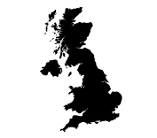

47% of European travellers intend to fly to their next destination, while 38% expect to drive
Top 5 markets most likely to travel by plane
in the next 6 months
Preferred modes of transport for respondents most likely
to travel in the next 6 months
Spain
63.7%
Poland
49.5%
UK
8.7%*
3.5%**
63.1%
France
46.2%
Italy
57.3%
31
Q15. Which of the following modes of transport would you most consider using during your next trip within Europe?
*Up to September ‘21. ‘By ship or ferry’ were included in ‘Other’
**Statistically significant difference vs previous survey period
No. of respondents: 4,391

Slide 32


The most popular length of stay for trips this summer is 4-9 nights
Intended length of stay (nights)
Envisaged budget
The budget is per person, including accommodation, transportation and travel activities
32% of Sun & Beach holiday makers will stay for 7-9 nights, whereas Nature & Outdoors and City Break travellers prefer shorter trips, up to 6 nights
Europeans planning Cruise, Culture & Heritage or Sun & Beach trips are more likely to spend 1,000-2,000 euros than the average traveller, who budgets <1,000 euros
32
Q19. What would be the length of your next overnight trip?
Q20. How much do you intend to spend on your next overnight trip (per person, including accommodation, transportation and travel activities)?
No. of respondents: 4,391

Slide 33









Over half of travel-ready Europeans favour hotel stays
Preferred type of accommodation for respondents most likely to travel in the next 6 months
52%
May ’22 survey
Mar ’22 survey
52% of guests in short-term rentals will spend up to 1,000 euros on their next trip, compared to 41% among those staying at chain hotels or at resorts
Dec ‘21 survey
Sep ‘21 survey
Hotel chain or resort
Friends and/or family
Independent hotel/resort
Other paid serviced accommodation (bed and breakfast, etc.)
Hostel/motel
Short-term rental via online platform
Camping/caravan
Other
33
*Statistically significant difference vs previous survey period
Q16. Which of the following types of accommodation would you most consider staying at during your next trip within Europe?
No. of respondents: 4,391

Slide 34





Europeans’ travel confidence rises: The number of travellers who have fully booked their next trip increases (+6%), while uncertainty over which destination to visit decreases (-4%)
Status of planning for the next trip
4.2%*
I have not yet chosen where I will travel next
I have chosen where I want to go but not yet booked/arranged my trip
I have booked/arranged the accommodation for my next trip
I have booked/arranged the transportation for my next trip
6.1%*
I have booked/arranged all travel and accommodation components for my next trip
34
* % change vs previous survey period
Q21. Please select a response which best describes the planning for your next trip:
* Statistically significant difference vs previous survey period
No. of respondents: 3,822
No. of respondents: 4,606

Slide 35
Despite the growth in travel confidence, the booking window remains relatively narrow:
almost half of the trips planned for June-July are only partially booked or are not yet booked
Booking status
and timing of next trip
Booking status
and travel destination
June-July
August-September
October-November
May ‘22 survey
35
Q21. Please select a response which best describes the planning for your next trip:
No. of respondents: 6,005

Slide 36






Spending time in the great European outdoors, (19%), immersion in a destination’s lifestyle (16%), and learning more about local gastronomy are travellers’ most anticipated experiences for the next months
Baby boomers (over 54 years old) demonstrate higher interest in tasting the local cuisine, experiencing the local culture and learning about history and culture, while Gen Z travellers (18-24 years old) care more about active holidays and spa & wellness
16.4%
13.7%
8.9%
18.5%
15.8%
12.3%
Taste the local cuisine
and gastronomic products
See famous
landmarks
Active holiday
experiences
Enjoy nature, see scenic landscapes
Experience the local culture and lifestyle
Learn about history
and culture
May ‘22 survey
36
Q8. Which of the following travel experiences will you look for during your next trip in Europe?
No. of respondents: 4,391
* New question

Slide 37








Pleasant weather, attractive deals and fewer crowds are the key elements for the selection of a holiday destination this summer
Top 8 criteria for choosing the next travel destination
May ‘22 survey
37
Q6. What criteria will play the most important role in choosing your next holiday destination?
* New question
No. of respondents: 6,005

Slide 38
TRAVEL CONCERNS
03

Slide 39





Over one-third of Europeans (34%)— the highest level since August 2020 —
will execute their travel plans without any impact from COVID-19
How has COVID-19 affected travel plans?
Top 5 markets choosing domestic over international travel
Did not plan
to travel
I had not planned any overnight trips in the next 6 months
It did not affect me at all
I made the trip with some changes from the initial plan (accommodation/transport)
I changed my trip from international to domestic
I changed the destination so I can use my own vehicle to travel
I rescheduled it for another date
I cancelled my trip completely
Italy
Did not make any change to the original plan
17.3%
7.8%*
Poland
14.7%
Spain
13.9%
Had to make some changes to their original plan
Austria
12.4%
Germany
Cancelled
12.3%
39
Q2. If you were planning to take an overnight trip in the next 6 months within Europe, how has COVID-19 affected your plans?
* Statistically significant difference vs previous survey period
No. of respondents: 6,005

Slide 40

The war in Ukraine had no effect on the travel plans of 44% of Europeans,
but it caused 31% to make some changes to their original planning and 4% to completely cancel their trip
How has the ongoing war between Russia and Ukraine affected your travel plans?
Top 5 markets to make changes
in their trip planning
I had not planned any overnight trips in
the next 6 months
It did not affect me at all
I will wait and see how the war evolves before booking a trip
I made the trip with some changes from
the initial plan (accommodation/ transport)
I changed my trip from international to domestic
I changed my itinerary to avoid countries neighbouring the conflict zone
I rescheduled it for another date
I cancelled my trip completely
Switzerland
50.9%
Italy
44.3%
May ‘22
survey
Spain
37.3%
Austria
37.1%
Poland
35.9%
40
Q3. How has the ongoing war between Russia and Ukraine affected your plans to travel within Europe in the next 6 months?
* New question
No. of respondents: 6,005

Slide 41
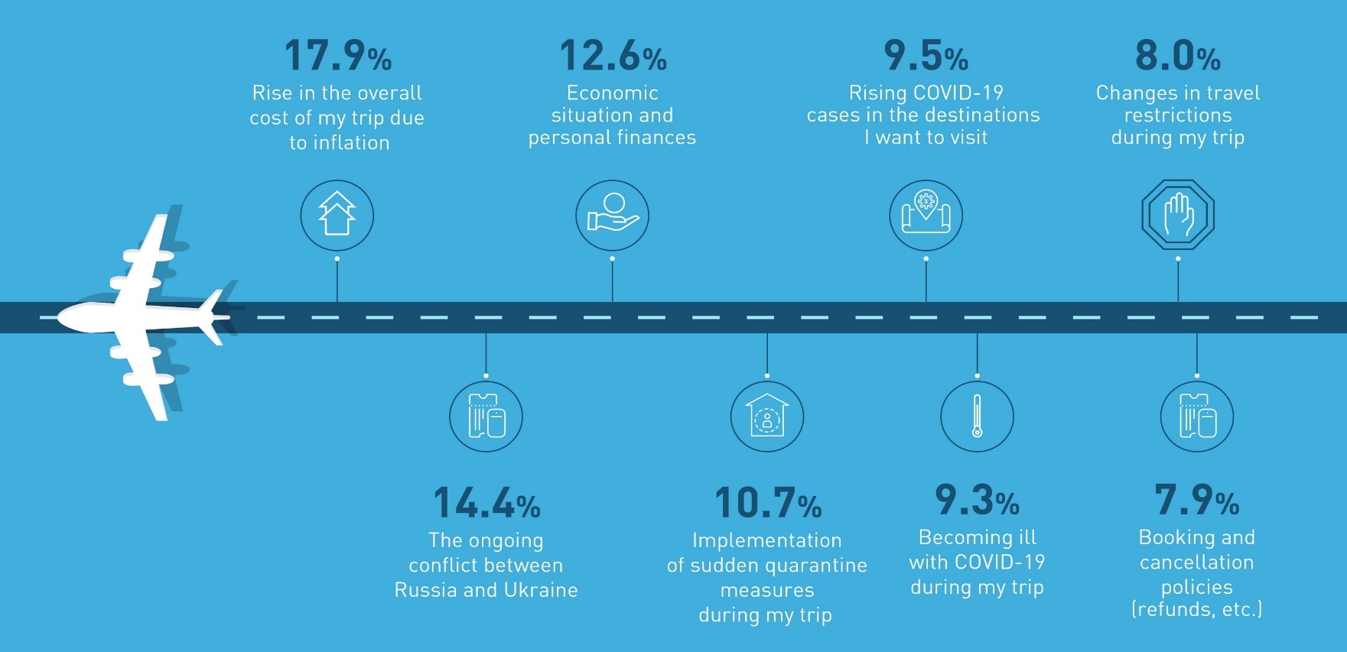
EUROPEAN TRAVELLERS’ CONCERNS
Economic concerns regarding price inflation (18%) and personal finances (13%) are travellers’
key sources of distress, while the war in Ukraine (14%) is an additional major concern
Leading concerns for those who are most likely to travel next
3.9%*
6.6%*
4.4%*
41
Q4. What currently concerns you the most about travelling within Europe?
The answers to this question have been enriched in May ‘22, to include references to the war in Ukraine and cost & inflation issues.
May ‘22 survey
No. of respondents: 4,391

Slide 42






Although sentiment towards strict health & safety protocols drops (-12%), the protocols remain essential for the comfort of 55% of European travellers
Sentiment towards strict health & safety protocols
62.8%
58.6%
66.8%
55.3%
11.5%*
The sentiment towards strict health & safety protocols is particularly high among travellers from Italy (77%) and Spain (71%), compared to 55% in the overall sample
7%*
**This refers to the total sample
42
Q7. Please select a response which describes you the most:
“When I travel to places with strict health and safety protocols…”
* No significant changes between waves were recorded for this question
No. of respondents: 4,391

Slide 43
METHODOLOGICAL ANNEX
04

Slide 44
METHODOLOGICAL ANNEX
THE SURVEY
The report is the result of online market research of Europeans who took at least 2 overnight trips during the last three years (2019-2022)
Distribution/data collection period:
  Wave 9: 10-18 September 2021; sample = 5,769 / Wave 10: 23-31 December 2021; sample = 6,002 / Wave 11: 01-09 March 2022; sample = 5,998 /
  Wave 12: 09-12 May 2022; sample = 6,005
  Countries: Germany, United Kingdom, France, Netherlands, Italy, Belgium, Switzerland, Spain, Poland and Austria
  Languages: English, French, German, Italian, Spanish, Polish and Dutch
Research themes examined: Travel personas (1 question), Travel concerns and impact of external shocks on travel (7 questions) and Travel intentions, preferences and trip planning (13 questions)
47% of the Wave 12 survey respondents are male and 53% are female. Sample size and age groups are listed below:
 |  | Country |  |  |  |  |  |  |  |  |  | Total
 |  | UK | IT | ES | AT | FR | DE | PL | BE | CH | NL
Age | 18 - 24 | 88 | 73 | 45 | 80 | 96 | 93 | 56 | 106 | 119 | 112 | 868
 | 25 - 34 | 135 | 112 | 74 | 159 | 129 | 153 | 107 | 128 | 173 | 151 | 1,321
 | 35 - 44 | 126 | 135 | 101 | 139 | 141 | 150 | 120 | 111 | 133 | 111 | 1,267
 | 45 - 54 | 139 | 167 | 105 | 65 | 146 | 168 | 94 | 98 | 52 | 57 | 1,091
 | ≥55 | 263 | 263 | 175 | 57 | 238 | 187 | 125 | 57 | 23 | 70 | 1,458
Total |  | 751 | 750 | 500 | 500 | 750 | 751 | 502 | 500 | 500 | 501 | 6,005
44

Slide 45


Copyright © 2022 European Travel Commission (ETC)
Study on Monitoring Sentiment for Intra-European Travel
All rights reserved. The contents of this report may be
quoted, provided the source is given accurately and
clearly. Distribution or reproduction in full is permitted for
own or internal use only.
While we encourage distribution via publicly accessible
websites, this should be done via a link to ETC’s
corporate website, www.etc-corporate.org
Data sources: This report is based on research conducted
by MINDHAUS (www.mindhaus.gr) and should be interpreted by users according to their needs.
Please note that while every possible effort has been made to ensure the data in this report is accurate, it is not possible to completely eliminate every margin of error.
Published by the European Travel Commission
Rue du Marché aux Herbes, 61,
1000 Brussels, Belgium
Website: www.etc-corporate.org
Email: info@visiteurope.com
ISBN No: 978-92-95107-62-5
Cover photo: @Andrey Armyagovt ,Family vacation travel RV, holiday trip in motorhome, Caravan car Vacation. Beautiful Nature Norway natural landscape.
Photo ID: 1017257911
Design: MINDHAUS

